Slide 1



AI Unlocked:
The Fundamentals
Presented by :

Slide 2
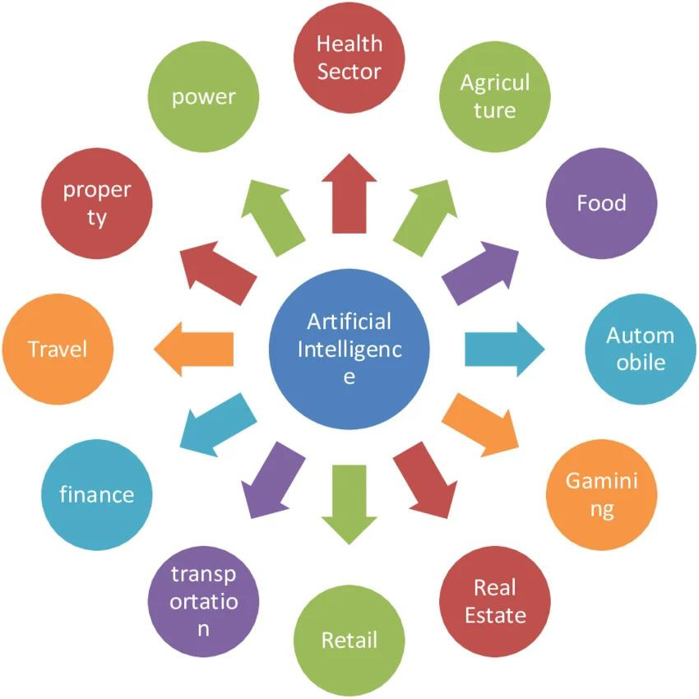
AI Fields of Application:

Slide 3
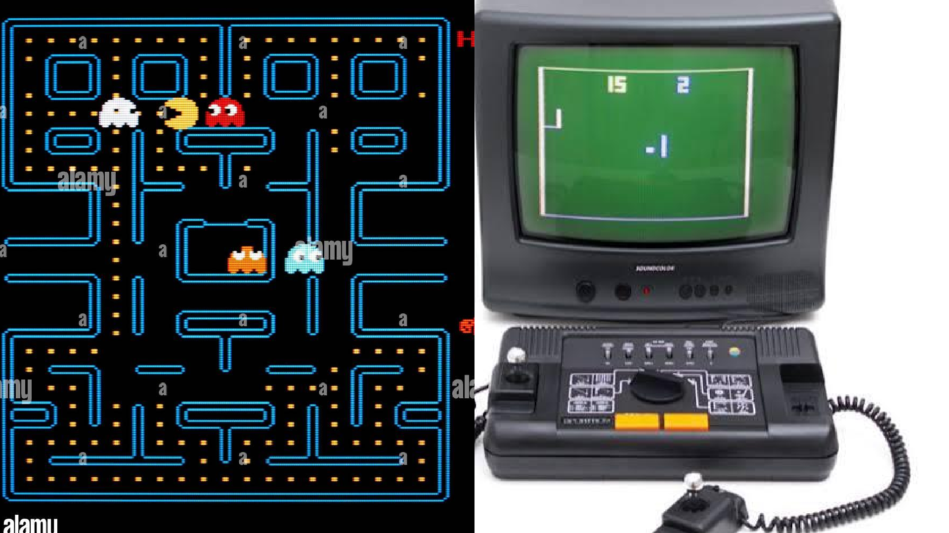

Slide 4
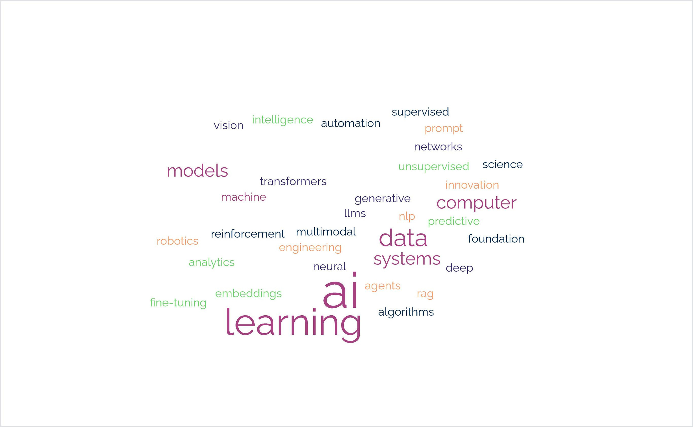
Artificial Intelligence?

Slide 5
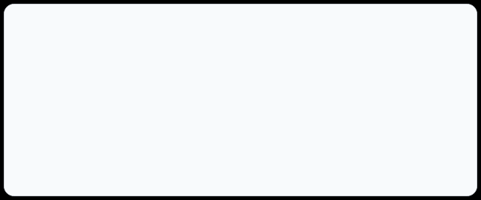


History of AI: Turing's Foundations
AlanTuringlaidthefoundationsofAIasearlyas1948–1950throughtwo core pillars:
1948 Foundation
1950 Foundation
Ancestors of Neural Networks
Theorized "unorganized machines"learning through trial and error (reinforcement learning principle).
The Child Brain Concept
Proposed simple systems that learn from data and experiencerather than hand-coded human knowledge.

Slide 6
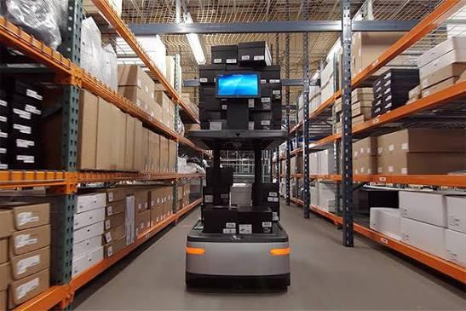
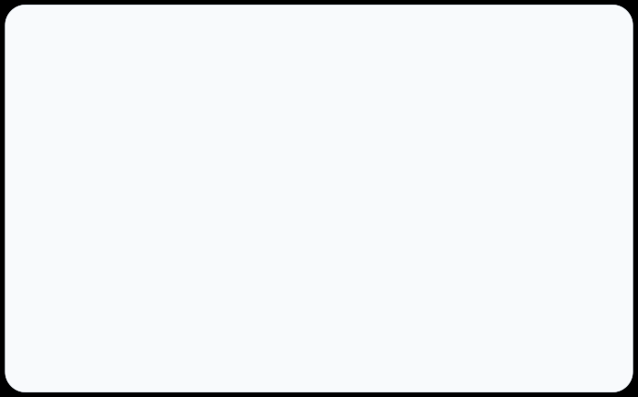
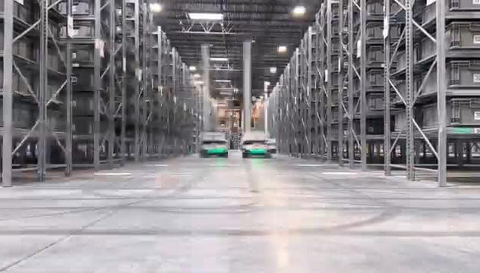
Robot seem as single AI system but several AI systems run in parallel !
•Environment Mapping System → Computer Vision
•Object Identification System → Deep Learning
•Grip & Movement Control System → Machine Learning

Slide 7
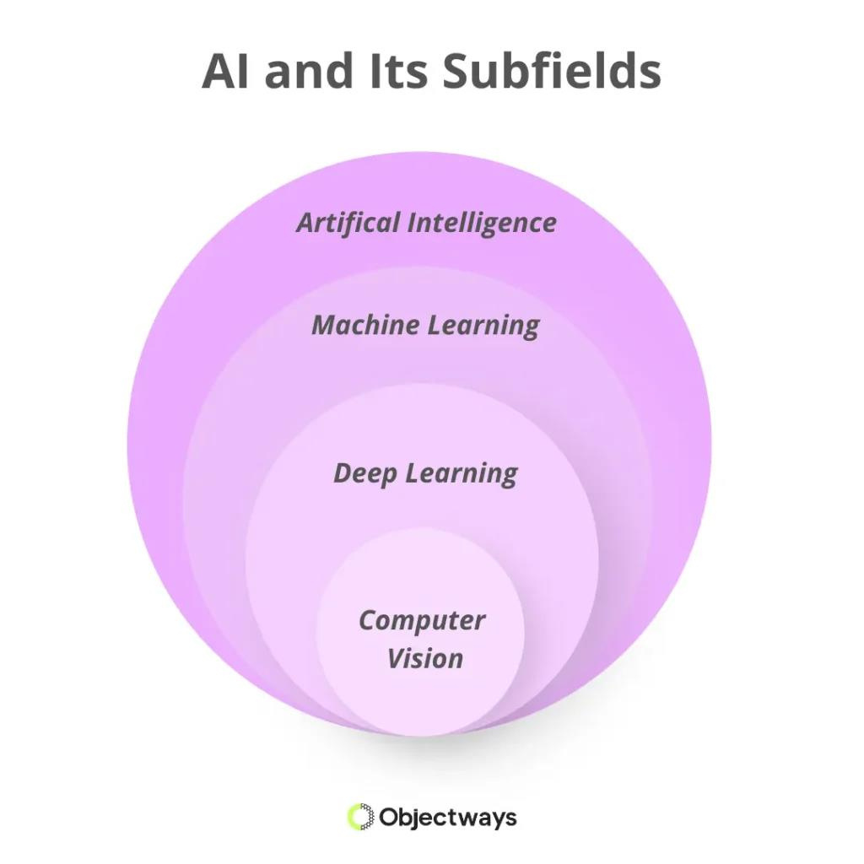
Hierarchy of Artificial Intelligence

Slide 8

AI UNLOCKED: SECTION 01
THE PRE-STATISTICAL ERA
Symbolic NLP
Howweprocessedlanguagebeforemachinelearning
anddeepneuralnetworks.

Slide 9

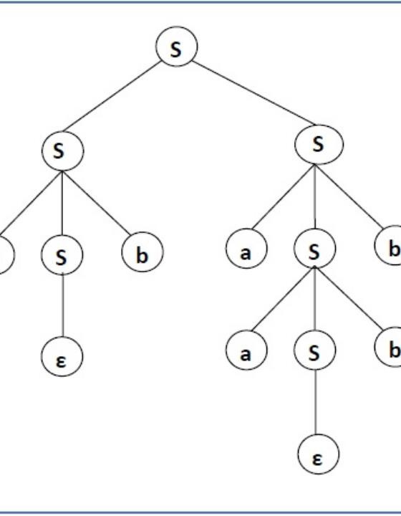
Parsing Syntax
Language mapped to logic.
Noun and verb phrases.
Rigid mathematical equations.

Slide 10
The Rule-Based Pipeline
1
2
3
Tokenization
Splitting sentences into words.
Stemming
Stripping linguistic affixes.
Rule Parsing
Applying logical grammar constraints.

Slide 11
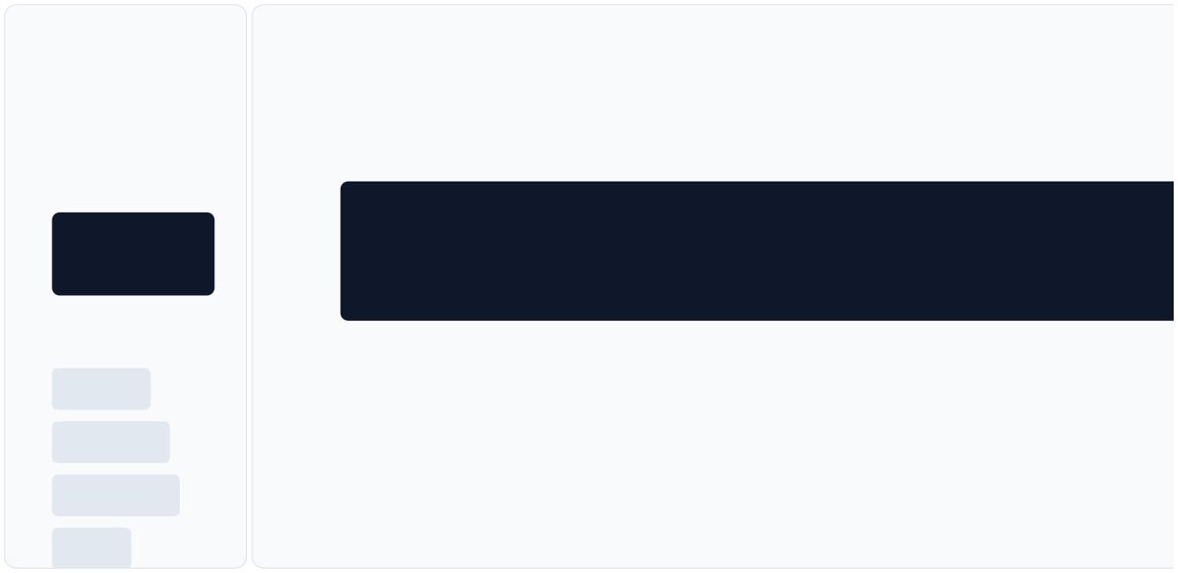
Pipeline in Action
1. Tokenization
2. Parsing
Syntactic Structure:
Input String:
S ├── NP (Noun Phrase) │ ├── Det: "The" │ └── N: "robot" └── VP (Verb Phrase) ├── V:
"The robot speaks."
"speaks" └── Punc: "."
Output Tokens:
["The"]
["robot"]
["speaks"]
["."]

Slide 12


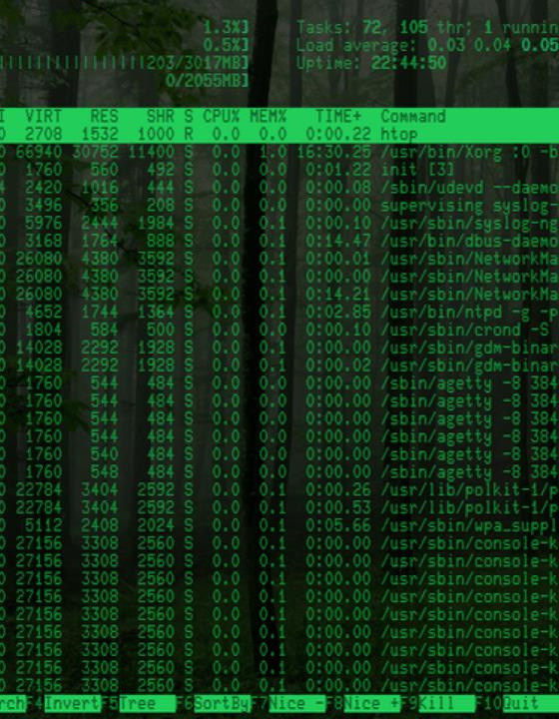
ELIZA (1966)
Theoriginal chatbot.
Simulated a psychotherapist. Relied on keyword substitution. Zero underlying comprehension.

Slide 13
The Rule-Based Tradeoff
Strengths
Weaknesses
Perfectly explainable logic. Zero training data required. High precision in niches.
Brittle edge cases. Combinatorial rule explosion. Expensive expert labor.

Slide 14
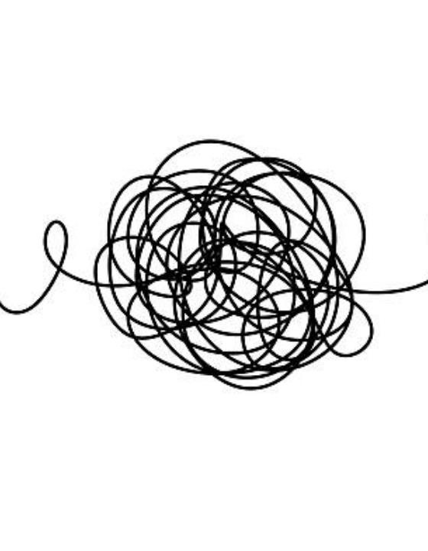
The Ambiguity Wall
Language is inherently messy.
Sarcasm breaks logic rules. Context changes fixed meanings.

Slide 15
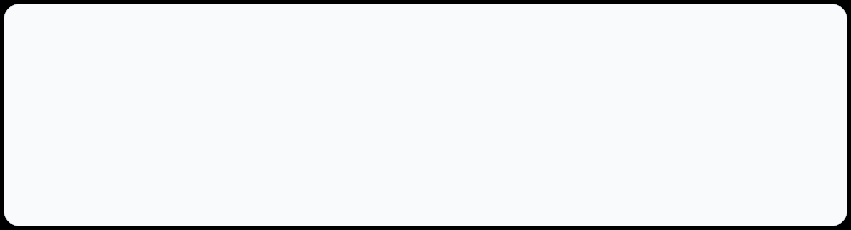
AI UNLOCKED: SECTION 02
An Overview of Machine Learning (Core Engine)
You can think of machine learning as training a model to make decisions from data. Instead of relying only on fixed, handwritten rules, the model learns patterns from examplesand improves as it is trained and evaluated. Once trained, it can make predictions, classify inputs, find trends, or flag unusual casesbased on what it
learned.
Data Decisioning
Pattern Learning
Continuous Evaluation
Multi-Output Tasks

Slide 16
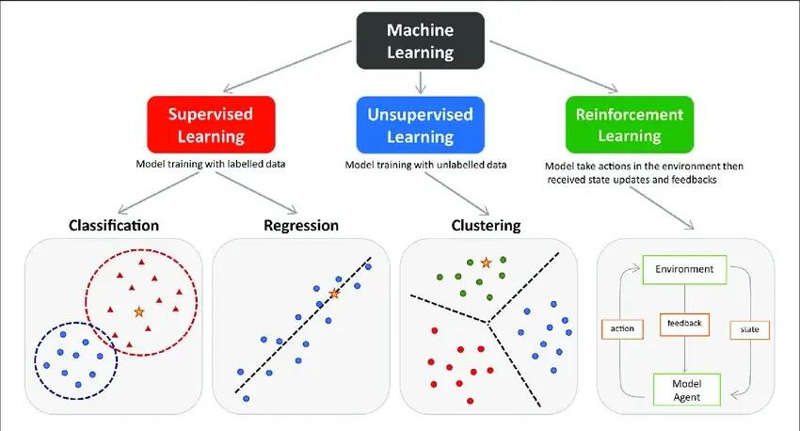

Slide 17

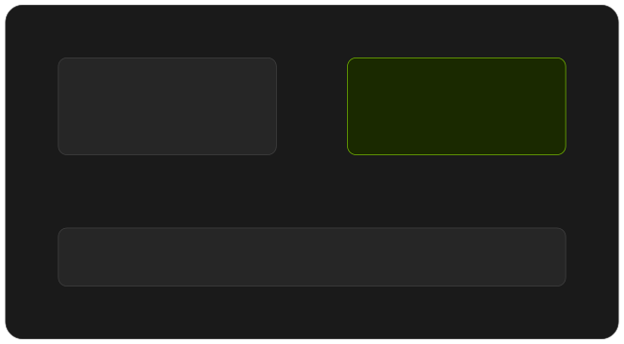
What is Supervised Learning?
Labeled Data
AI Model
Learningwithateacher.Trainingamodel
Prediction
Compare to truth
using examples paired with their correct answers.

Slide 18




THE MECHANICS
How Supervised Learning Works
Training Data
AI Model
Prediction
Loss/Error
Update
Features + Labels.
Makes a prediction.
Model's best guess.
Compare to truth.
Adjust parameters.
Process repeats iteratively until the model learns useful patterns.

Slide 19
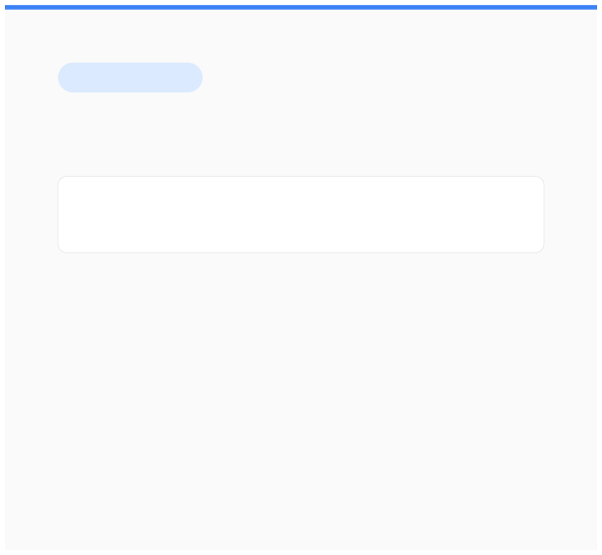
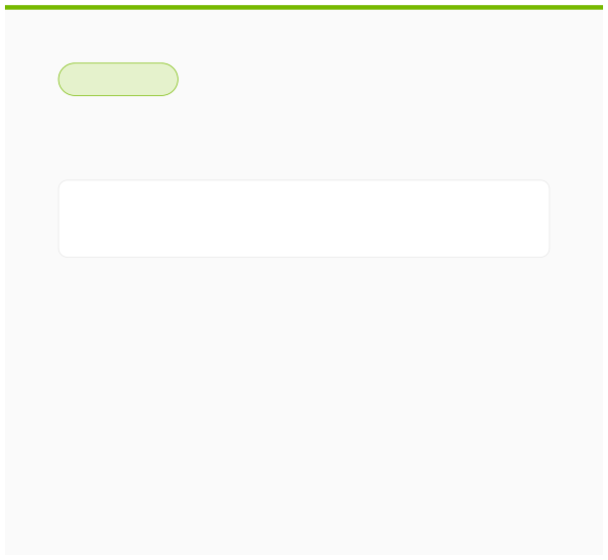
Two Major Branches
CLASSIFICATION
REGRESSION
Predicts a category.
Predicts a numerical value.
Input
[ Class A | Class B ]
Input
[ 72.4 ]
Spam vs Not Spam Fraud vs Legitimate Disease vs No Disease
House price prediction Sales forecasting
Temperature prediction

Slide 20
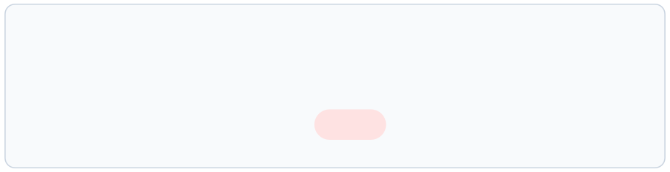
Example: Spam Detection
Learningpatternsfromlabeledexamples.
"Congratulations! You won a prize!"
SPAM
"Meeting scheduled for 10 AM tomorrow."
NOT SPAM
"Claim your exclusive reward now!"
SPAM
NEW UNSEEN EMAIL
"URGENT: Click here to claim your gift!"
SPAM

Slide 21
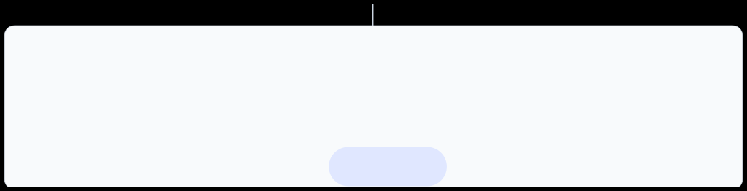
Example: House Price Prediction
Predictingcontinuouscontinuousnumericalvaluesfrominput features.
1,500 sqft, 3 Beds, 2 Baths, Suburban
$350,000
800 sqft, 1 Bed, 1 Bath, Urban
$420,000
2,200 sq ft, 4 Beds, 3 Baths, Rural
$280,000
NEW UNSEEN HOUSE
1,800 sq ft, 3 Beds, 2 Baths, Suburban
$385,000

Slide 22


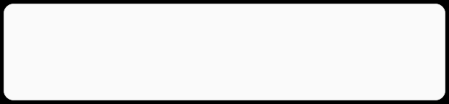

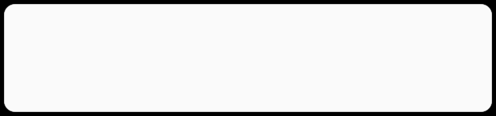
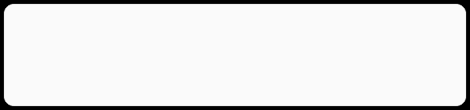
How Does the Model Learn?
Weights & Bias
Loss Function (L)
Featureinfluenceandadjustable baseline.
Measures prediction error.
Gradient Descent (∇L)
Backpropagation
Direction to reduce the error.
Calculatesparametercontribution to error.

Slide 23

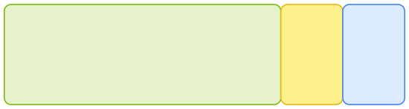
EVALUATION
Training vs Testing
Dataset Split
Train (70%)
Val
Test
Memorization ≠ Generalization
A good model doesn't simply memorize the training examples—it learns patterns that work on new data.
Training set:Learns the patterns. Validation set:Tunes model settings. Test set:Evaluates on unseen data.

Slide 24
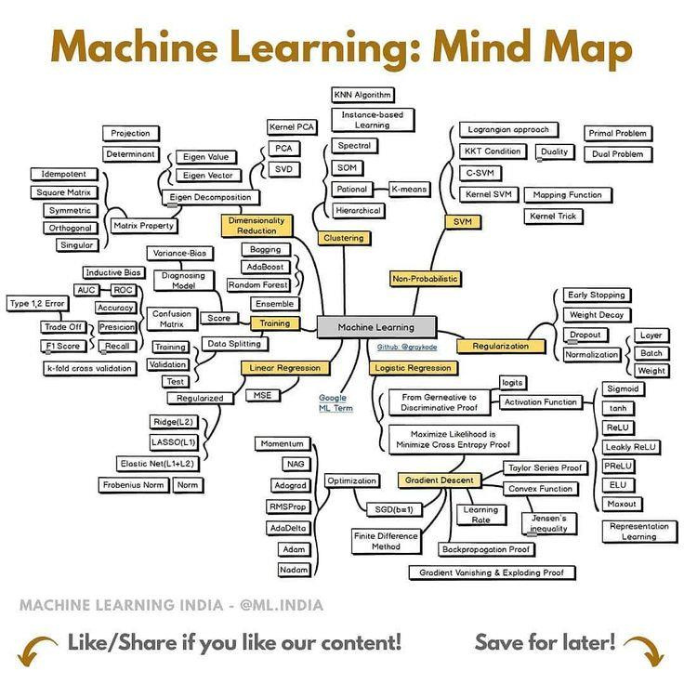

Slide 25
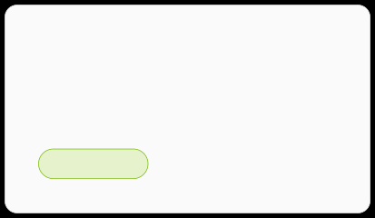
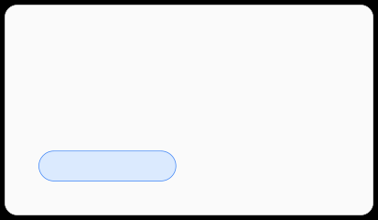
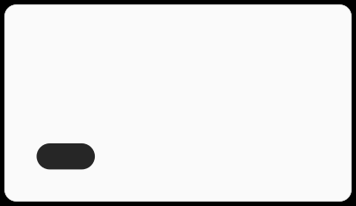


The Supervised Toolkit
Traditional ML and Neural Networks.
Linear Regression
Logistic Regression
Decision Trees
REGRESSION
CLASSIFICATION
BOTH
Support Vector Machines (SVM)
k-Nearest Neighbors (k-NN)
Neural Networks
BOTH
BOTH
BOTH

Slide 26
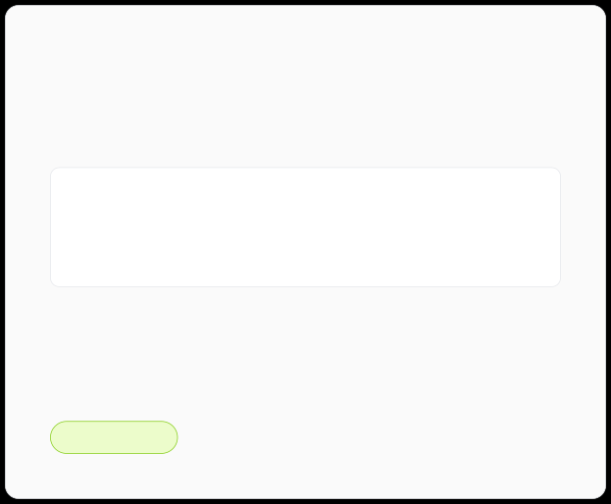
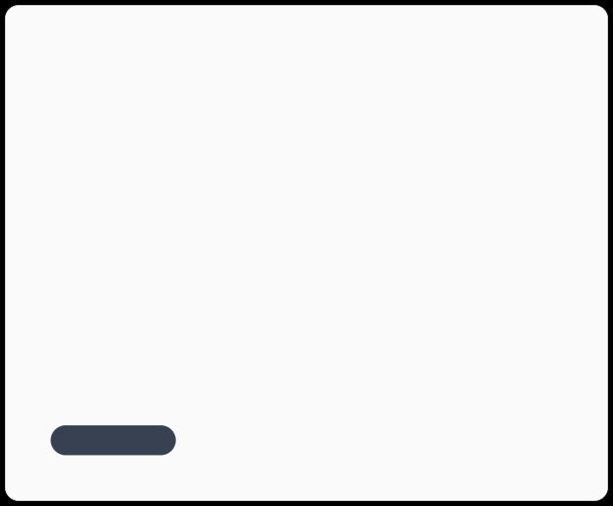

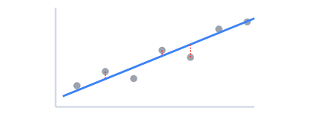
Linear Regression
Thefoundationalalgorithmforpredictingcontinuous values.
Core Mechanism
Line of Best Fit
Fitsastraightlinetoobserved data points.
Minimizesthedistanceto actual targets.
y = wx + b
REGRESSION
SUPERVISED

Slide 27

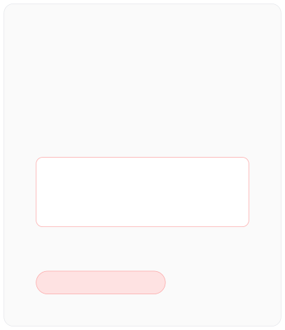
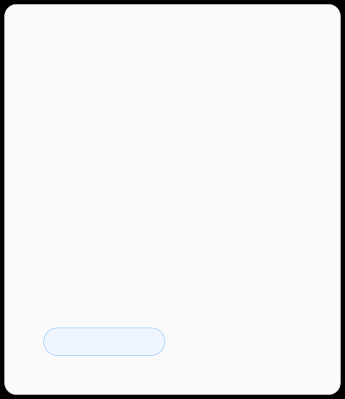
Method of Least Squares
Howlinear regressionfindsthe"bestfit"line.
1. Find the Errors
2. Square the Errors
3. Minimize the Sum
Measure the verticaldistance between real data points and the prediction line.
Makeall errorspositive and
strongly penalize large mistakes.
Adjust the line's slope and intercept until the total squared error is as small as possible.
REAL VALUE (Y) VS PREDICTED (Ŷ)
Σ (y -ŷ)²
RESIDUALS
PENALTY FUNCTION
OPTIMIZATION

Slide 28
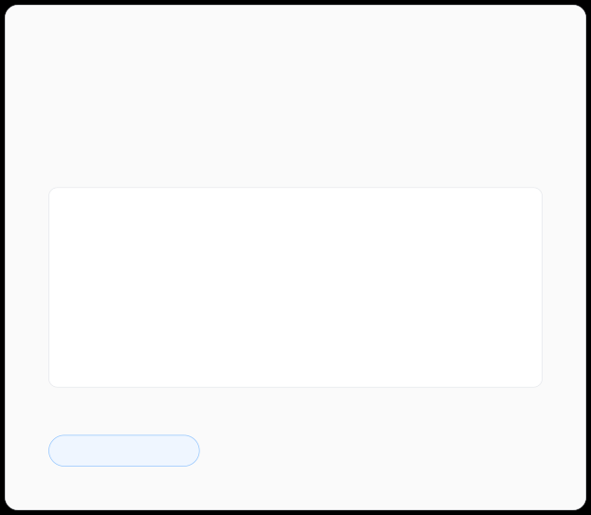
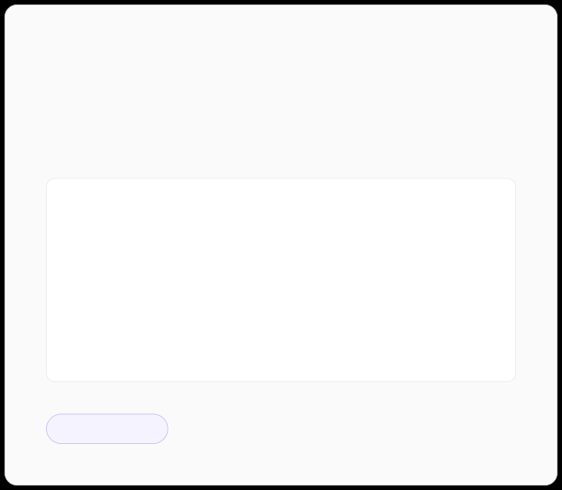
Logistic Regression
Despitethename,it'safoundationalalgorithmfor classification.
Binary Outcomes
Probability Output
Classifies dataintodistinctcategories rather than
Returnsalikelihoodscorestrictly between 0 and 1.
continuous values.
87%
Email Processing
Spam / Not Spam
Medical Tests
Positive / Negative
Transaction Risk
Fraud / Legit
PROBABILITY OF CLASS A
CLASSIFICATION
PROBABILITY

Slide 29
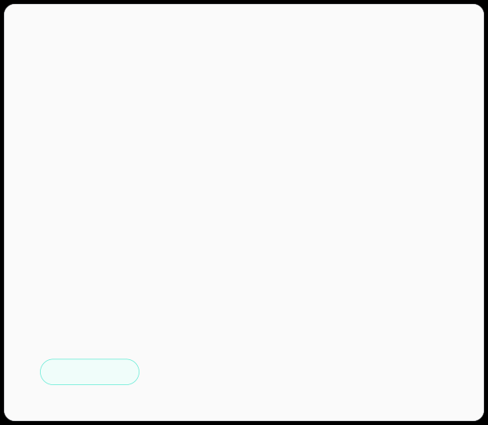
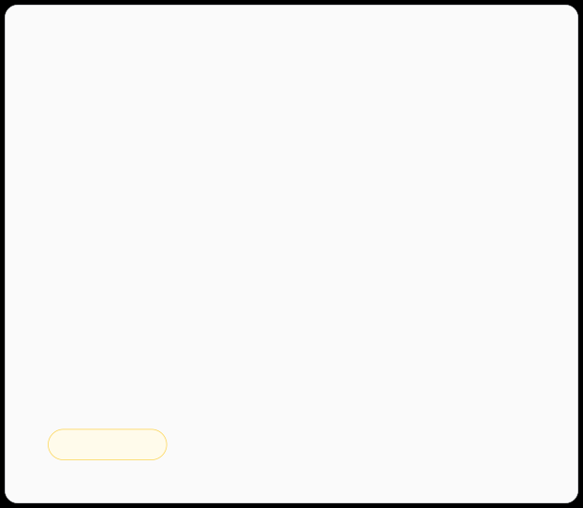
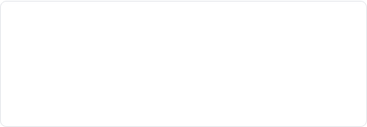
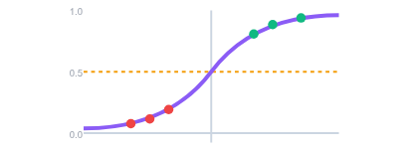

The Sigmoid Function
Squashinginfinitelinearpredictionsintoabounded probability curve.
The S-Curve Math
Decision Threshold
Mapsanyreal-valuednumber into the (0, 1) range.
Acutoff(usually0.5)determines the final predicted
class.
ACTIVATION
THRESHOLD

Slide 30
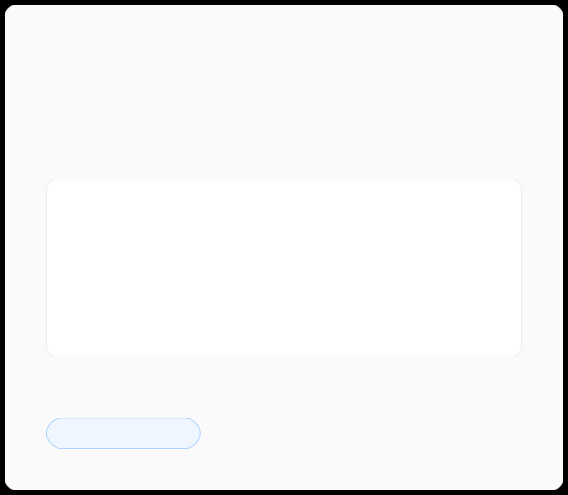
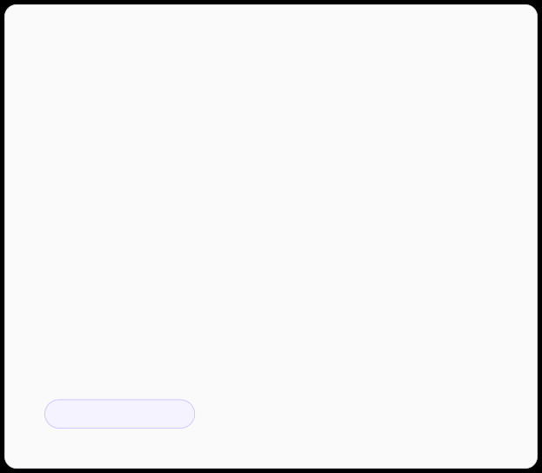
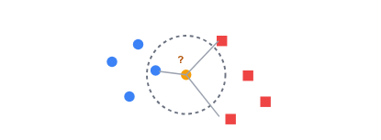
k-Nearest Neighbors (k-NN)
Predictingoutcomesbasedonspatialproximity infeaturespace.
Distance as Similarity
The Majority Vote
Assumessimilardatapointsexistin close proximity to each other.
Thehyperparameter 'k' determines how many
neighbors influence the prediction.
Euclidean
Straight-line distance
Manhattan
Grid-like distance
Cosine
Angle-based similarity
INSTANCE-BASED
NON-PARAMETRIC

Slide 31

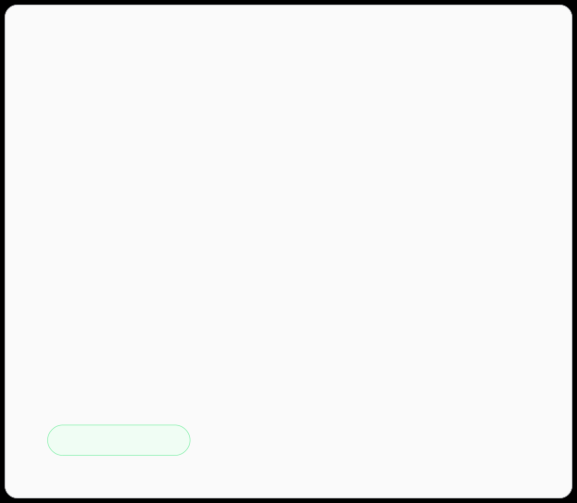

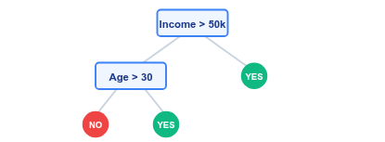
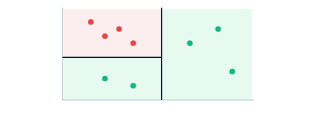
Decision Trees
Learningthroughasequentialhierarchy of if-then-else rules.
Recursive Splitting
Non-Linear Boundaries
Dividesdatacontinuouslytomaximize purity at each new node.
Createsrigid,box-likedecisionregions in the feature space.
RULE-BASED
INTERPRETABLE

Slide 32
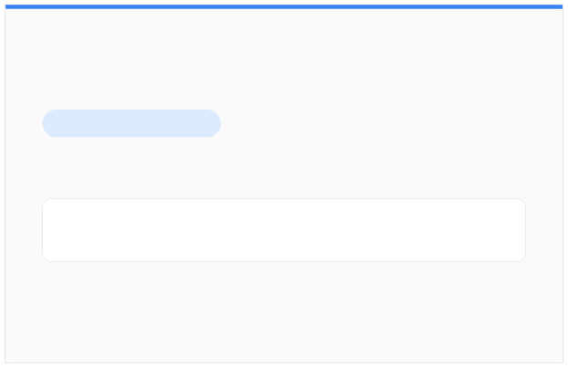
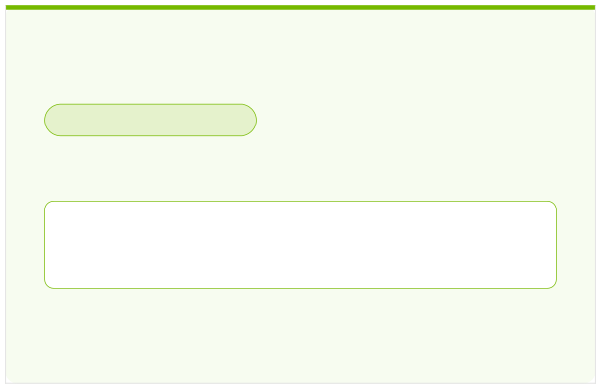
What is Unsupervised Learning?
Unsupervisedlearningdiscoverspatternsandstructureindatawithoutpredefined labels.
SUPERVISED LEARNING
UNSUPERVISED LEARNING
Learning with a Teacher
Self-Guided Discovery
Input + Correct Answer → Model → Prediction
Raw Unlabeled Data → Model → Discovered Structure
Give the model data without labels → let it discover hidden structure on its own.

Slide 33








THE DISCOVERY PIPELINE
How Unsupervised Learning Works
1. Raw Data
2. Find Similarities
3. Discover Structure
4. Human Interpretation
Unlabeled inputs without target
Evaluates distance, density &
Groups, dimensions, or anomalies.
Humans assign meaning to
outputs.
correlation.
patterns.
The algorithm discovers mathematical structure —humans interpret what that structure represents.

Slide 34




The Four Main Tasks
Corecapabilitiesofunsupervisedmodels.
1. Clustering
2. Dimensionality Reduction
"Whichdatapointsbelong together?"
"Canwe simplify high-dimensionaldata?"
Groups customers by spending behavior.
Compresses 100 features into 2D plots.
3. Anomaly Detection
4. Association Mining
"Whichobservationslook unusual?"
"Whichitemsoccurtogether?"
Flags suspicious credit card charges.
"Customers who buy X often buy Y."

Slide 35
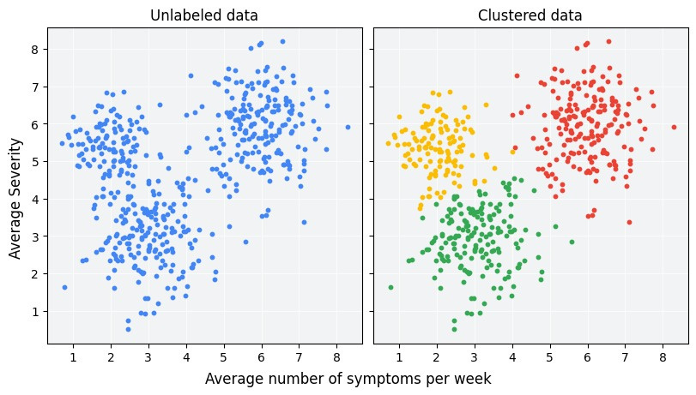
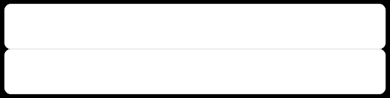
Clustering: Finding Natural Groups
Discoveringcategoriespurelyfromfeaturecharacteristics.

Slide 36

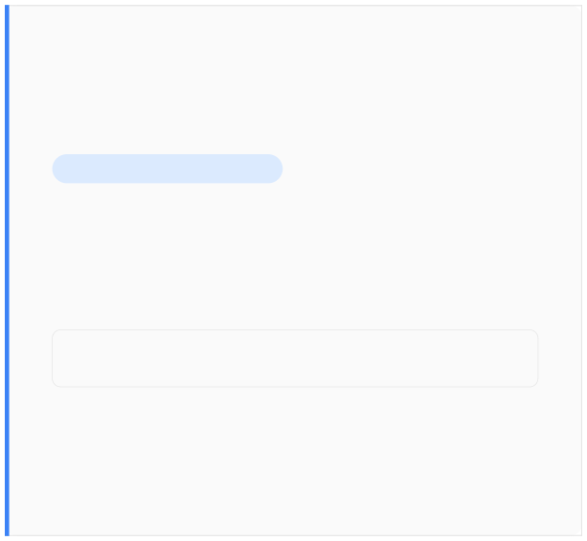
Anomalies & Dimensionality
ANOMALY DETECTION
DIMENSIONALITY REDUCTION
Identifies Extreme Outliers
Detects observations operating outside expected density bounds.
Simplifies Complex Features
Projects100+ feature dimensions into readable 2D or 3D
spaces.
Applications:Fraud detection, system intrusions, equipment failures.
Key Method:Principal Component Analysis (PCA).

Slide 37



Unsupervised Toolkit
Corealgorithmscategorizedbyprimaryfunction.
CLUSTERING
DIMENSIONALITY
ASSOCIATION
K-Means:Centroid distance DBSCAN:Density spatial regions Hierarchical:Nested tree structures
PCA:Linear variance projection t-SNE:Non-linear cluster map UMAP:Manifold structure mapping
Apriori:Frequent itemset rules
FP-Growth:Tree-based pattern mining

Slide 38





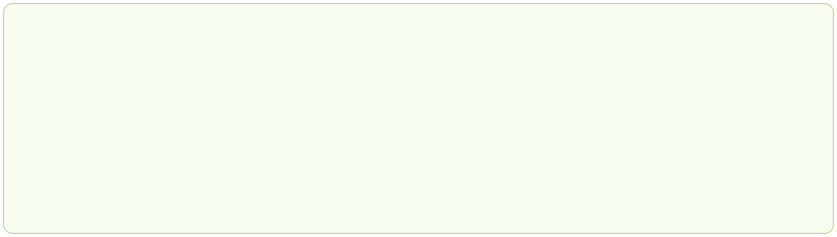
Real-World Applications
Customer Segmentation
Fraud Detection
Biological Genomics
Defect Spotting
Recommendation Discovery
Unsupervised learning unlocks insights from vast pools of unannotated data across modern industries.

Slide 39

Reinforcement Learning (RL)
Learning through interaction, trial, and error feedbackto maximize cumulativereward.
AGENT
ACTION
ENVIRONMENT
REWARD
Continuous Decision Feedback Loop

Slide 40


FOUNDATIONAL CONCEPT
Learning Through Trial & Reward
Anagentlearnstomakeoptimaldecisionsbytakingactionsinanenvironment to achieve a goal.
KEY DISTINCTION
INTUITIVE ANALOGY
No Explicit Teacher
Unlike Supervised Learning, no supervisor provides correct step-by-step labels. The agent evaluates its own choices over time.
Learning a Video Game
Try a new controller input
Observe score change or crash
Gain points (+Reward) or lose lives (-Penalty)
Refine strategy for next attempt
Learns directly from outcome consequences.

Slide 41




THE CORE ENGINE
The RL Interaction Loop
Agent
Environment
Thelearner or decision-maker.
Theworldwhereagent acts.
EXAMPLE: ROBOT IN MAZE
State:Robot at intersection (X=3, Y=2)
State (S)
Action (A)
Currentsituation of environment.
Adecisiontaken by agent.
Action:Move Left
Reward (R)
Reward:+10 (Goal) / -5 (Wall collision)
Feedbacksignal evaluating outcome quality.

Slide 42



PROGRESSION & ADAPTATION
From Chaos to Optimal Strategy
1
2
3
Early Stage
Mid Stage
Late Stage
Random actions & frequent mistakes.
Identifies rewarding patterns & reduces errors.
Mastered policy & highly efficient execution.
LOW REWARDS
GROWING RETURNS
OPTIMAL REWARD
Observe State →Choose Action →Receive Reward →Update Strategy

Slide 43


THE CENTRAL TRADE-OFF
Exploration vs. Exploitation
EXPLORATION
EXPLOITATION
Try Something New
Use What Works
Experimentswithunfamiliaractionsto discover better strategies.
Leveragesexistingknowledgeto secure guaranteed high rewards.

Slide 44


Core Building Blocks
Howtheagentdecidesandevaluates.
Value Function (V/Q)
Policy (π)
Long-Term Expected Return
Estimates total cumulative reward starting from a specific state.
The Decision Strategy
Maps current environment states to the best action to take.
Question answered:"What should I do right now?"
Question answered:"How good is this position long-term?"

Slide 45




Real-World Impact & Paradigm Comparison
Autonomous Driving
Robotics Control
LLM Alignment (RLHF)
Game AI & Strategy
Paradigm
Data Type
Feedback Mechanism
Primary Goal
Supervised
Labeled examples
Direct ground truth labels
Predict target output
Unsupervised
Unlabeled raw data
No feedback signal
Discover hidden structure
Reinforcement
Environment interactions
Rewards & penalties
Maximize cumulative reward

